Slide 1

Data Science & AI
Cultus

Slide 2
S.NO | Modules | No.of Hours
1. | Module 1: Excel-based EDA & Introductory Statistics | 40
2. | Module 2: Python Programming for Data Science | 50
3. | Module 3: Supervised Machine Learning (Track 1) | 60
4. | Module 4: Feature Engineering & Model Tuning (Track IV) | 40
5. | Module 5: Deep Learning (ANN, CNN, RNN) | 70
6. | Module 6: Capstone Projects & Industry Exposure | 40

Slide 3
Module 1: Excel-based EDA & Introductory Statistics
(Prep Course - Non-Programming)
Objective: Build foundation in data understanding and statistical thinking using Excel
Understanding Data & Problem Statemen
Categorical & Numerical Data Analysis
Data Visualization in Excel
Descriptive & Inferential Statistics
Hypothesis Testing

Slide 4
Understanding Data & Problem Statemen
What is data?
Data is information that is collected, stored, and used for analysis.
Age: 25
Marks: 87
Name: “Rahul”
Gender: Male / Female
Temperature: 32°C
City: Chennai
Customer rating: 4.5 stars
Photo or image
WhatsApp message text
Location: GPS coordinates

Slide 5
Types of Data
Structured: Tables, Excel, CSV
Unstructured: Images, audio, video
Semi-structured: JSON, XML
Real-Life Examples
Netflix → recommends movies
Amazon → suggests products
Banks → detect fraud
Ask students: Where do YOU see data?

Slide 6
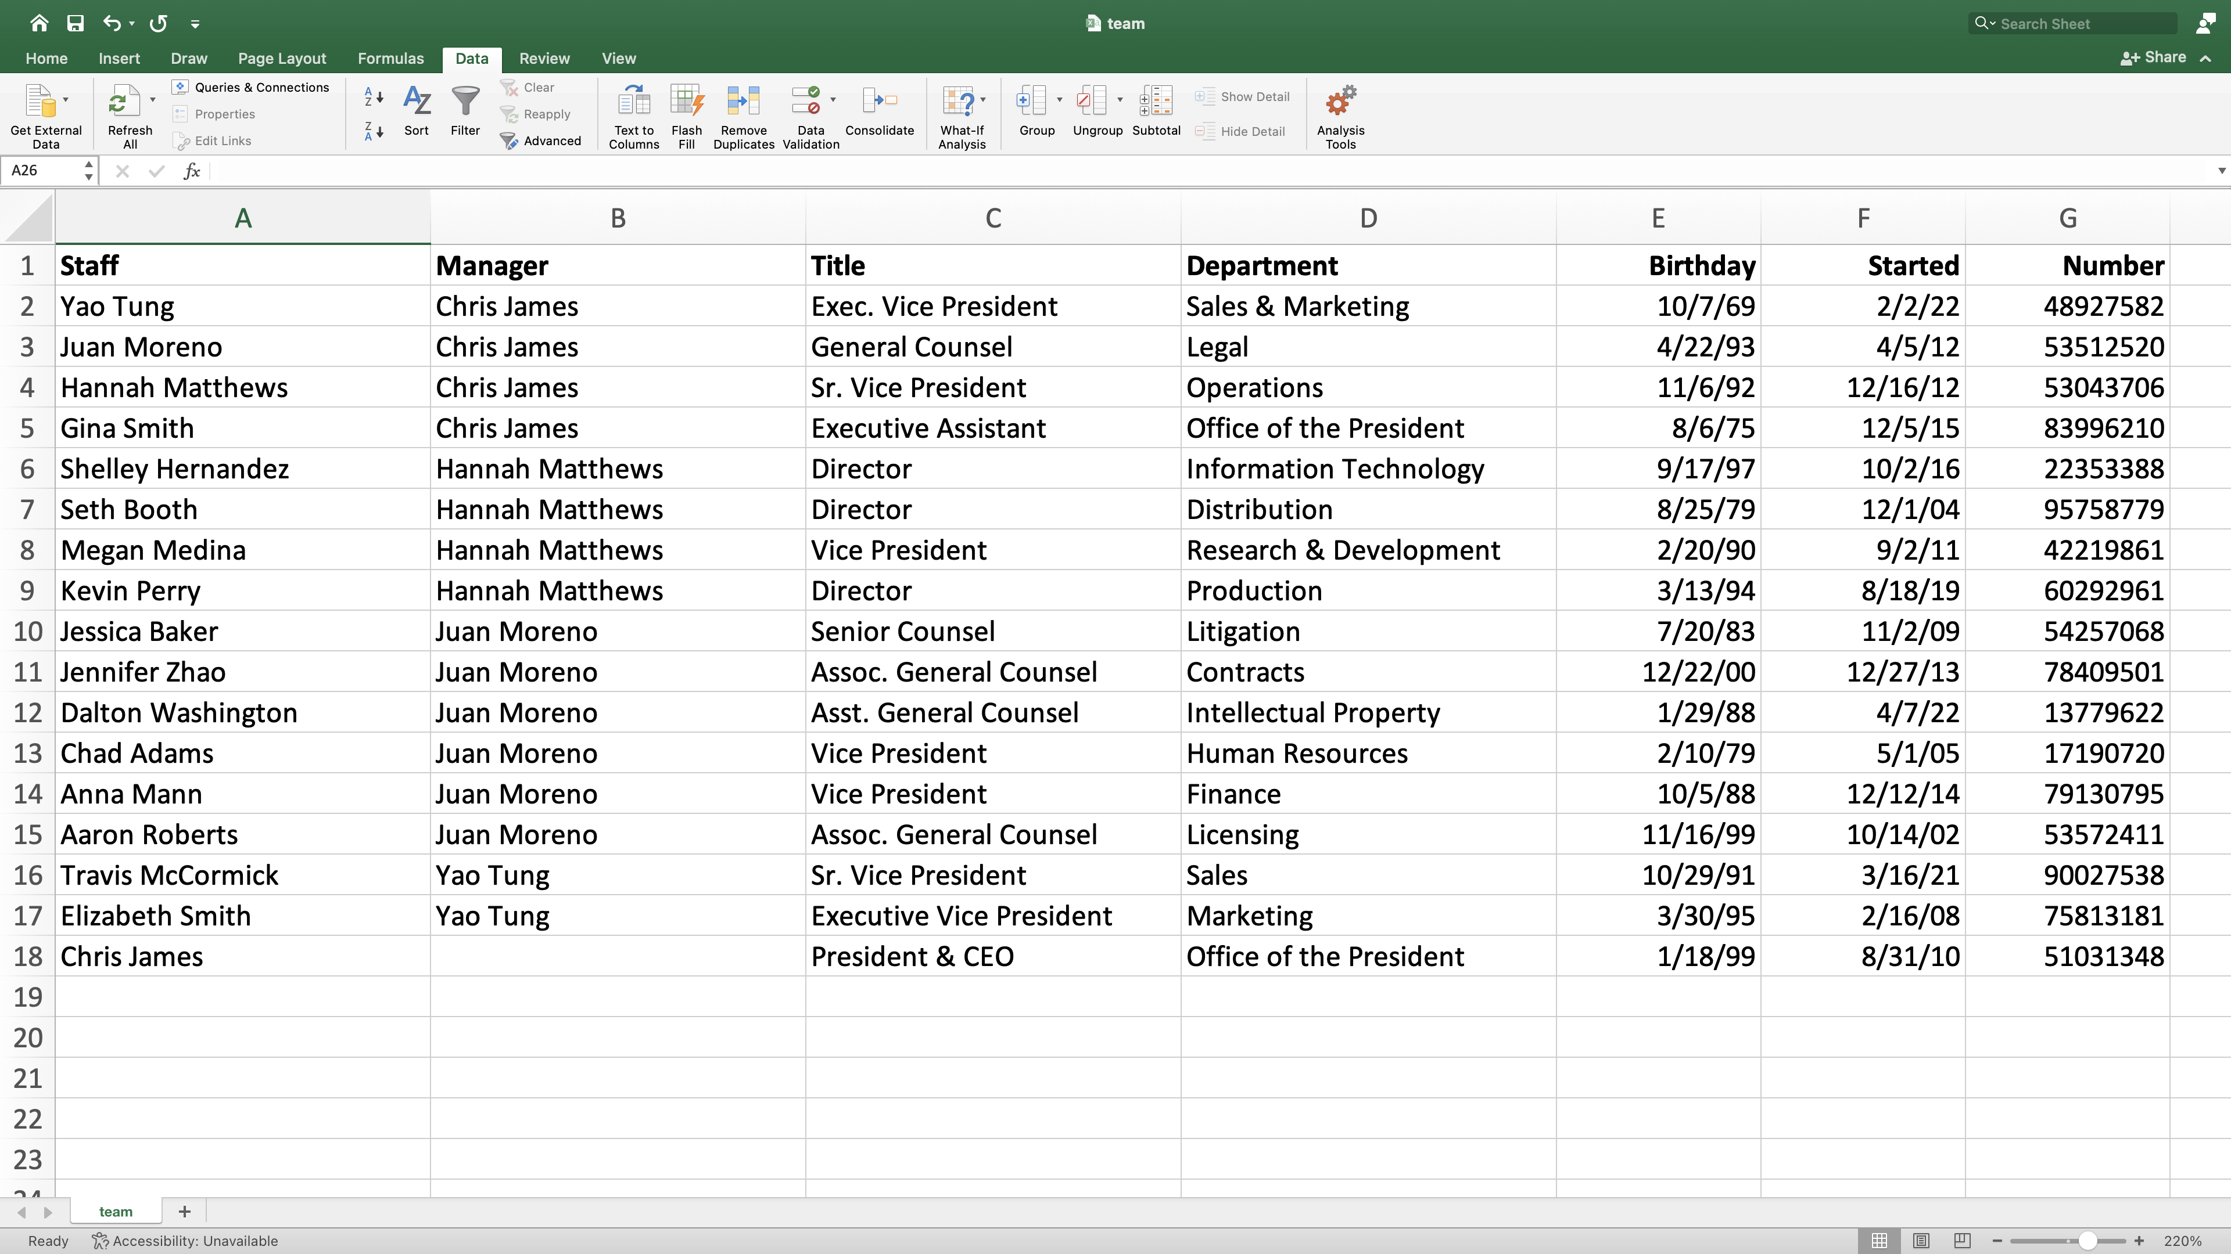
What Are Variables?
A variable is anything in a dataset that can change or vary.
Examples:
Age
Gender
Salary
Height
City
Rating
Every column in a dataset = a variable.

Slide 7
Types of Variables
Variables are divided into two main types:
Categorical Variables (Non-numeric)
Numerical Variables (Numbers)
Nominal Variables
Ordinal Variables
Continuous Numerical Variables
Discrete Numerical Variables

Slide 8
Categorical Variables (Non-numeric)
1. Nominal Variables
  No order
  Just categories
Examples:
  Gender: Male, Female
  City: Chennai, Bangalore
  Color: Red, Blue, Green
2. Ordinal Variables
  Order exists
  Difference between levels is not equal
Examples:
  Ratings: Poor < Average < Good < Excellent
  Education: 10th < 12th < UG < PG
  Shirt size: S < M < L < XL

Slide 9
Numerical Variables (Numbers)
1. Discrete Numerical Variables
  Whole numbers
  Countable
Examples:
  Number of siblings
  Number of orders
  Number of goals scored
2. Continuous Numerical Variables
  Can have decimals
  Measured values
Examples:
  Height
  Weight
  Salary
  Temperature

Slide 10
1. Nominal Level
Only names or labels
No order
Examples: City, Gender, Color
2. Ordinal Level
Ordered categories
But difference between ranks is unknown
Examples: Ratings, Education level, Shirt size
levels of measurement
3. Interval Level
Numerical values
Equal difference between values
No true zero
Examples:
Temperature (0°C does not mean “no temperature”)
4. Ratio Level
Numerical
Equal difference
True zero exists
Most analysis uses this
Examples:
Salary
Age

